Slide 1
Bangla Handwritten Digit Recognition
Presentation By-
Ahmad Umar Mahdi 193-15-1071
Bristy Saha 193-15-1077
Jannat Ara Shormee 193-15-1080
Shoaba Razzak 193-15-2958

Slide 2
Overview
Introduction
Motivation
Objective
Research Question
Methodology
Analysis
Output
Conclusion

Slide 3
Introduction
Handwritten Digit Recognition is used to recognize the Digits which are written by hand.
Plentiful works have already been done in Other Languages. But not that much in Bangla Handwritten Digit Recognition.
It is not easy to recognize Bengali Handwritten Digits due to differences in shape, size and writing style.
We used TensorFlow’s Keras API to build system because it is best in this scenario.

Slide 4
Motivation
Our main motivation to take this topic was to learn about image processing in Python.
To learn applying Machine Learning Algorithms in image.
To build something that is really helpful for current generation.

Slide 5
Objective
Applying Machine Learning algorithms to a real-world problem by-
Converting images to Data Frame.
Appling Keras Modeling on that Data Frame.
Getting as best accuracy as possible.

Slide 6
Research Question
How is Keras related to TensorFlow?
Ans: TensorFlow is an open-sourced end-to-end platform, a library for multiple machine learning tasks, while Keras is a high-level neural network library that runs on top of TensorFlow.
What data is used to train and test the machine learning methods?
Ans: We are using BHaND Dataset which contains 70000 Handwritten Bangla Digits.

Slide 7
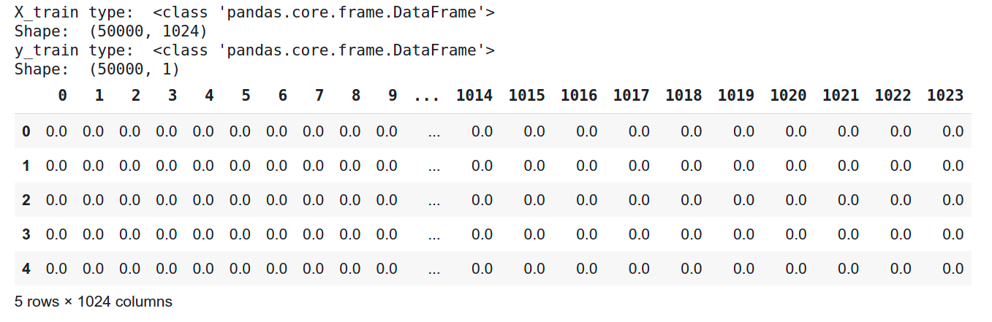
Methodology (Dataset)
From 70000 Handwritten Bangla Digits, we are using 50000 for training and 20000 for testing.
0 means white pixel, 1 means black pixel.
Here one row is represented as a single image. (32×32=1024)
Fig. : Dataset

Slide 8
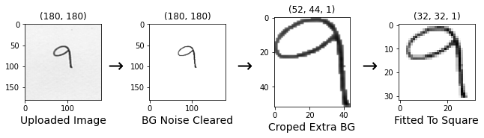
Methodology (Pre-processing)
Converting the image to 2D Array for pre-processing.
Clearing background noisy pixel (<0.5) to White pixel (0).
Converting 180×180 to 32×32.

Slide 9
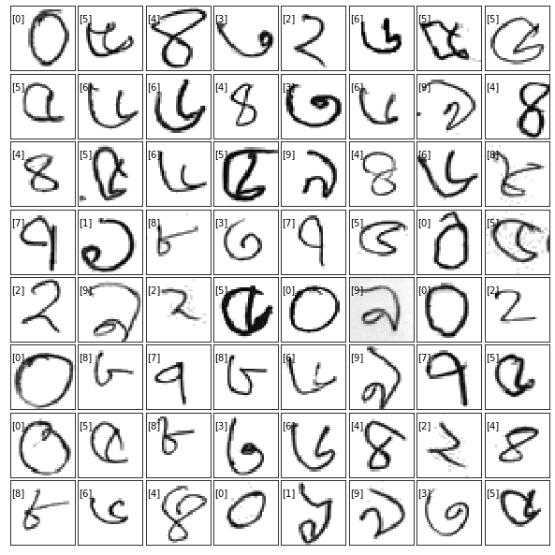
Analysis (Reshaping Data for Applying Algorithm )
We want to apply Tensor’s Keras Modeling.
Keras Modeling accept 4D Tensor data.
But our Data Shape is 2D. (50000, 1024)
Transforming our dataframe to a 4D tensor. (50000x32x32x1)
Now we can apply ML Algo.
Fig. : Reshaped Data

Slide 10
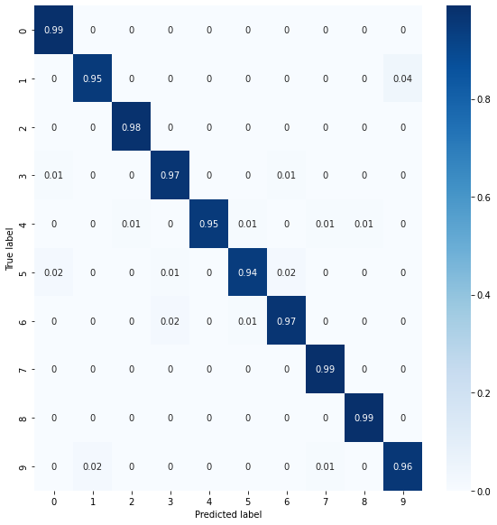
Output
In X axis we have Predicted Label.
In Y axis we have True Label.
We were able to get accuracy
of 99.03%.

Slide 11
Conclusion
In this research, we proposed to use deep learning approaches for handwritten Bangla digit recognition.
We evaluated the performance of Keras Modeling.
Among some the observation, the maximum accuracy in the performance was found 99%.
Research work is currently progressing to develop more.

Slide 12
Reference
Al Mehdi Saadat Chowdhury and M. Shahidur Rahman
BHaND Dataset: Towards optimal CNN parameters for bengali handwritten numerals recognition
AKM Shahariar Azad Rabby, Sheikh Abujar, Sadeka Haque and Syed Akhter Hossain
Bangla Handwritten Digit Recognition Using Convolutional Neural Network (DIU)
Fathma Siddique, Shadman Sakib and Md. Abu Bakr Siddique
Recognition of Handwritten Digit using Convolutional Neural Network in Python with Tensorflow and Comparison of Performance for Various Hidden Layers

Slide 13

Any Questions

Slide 14


